Slide 1
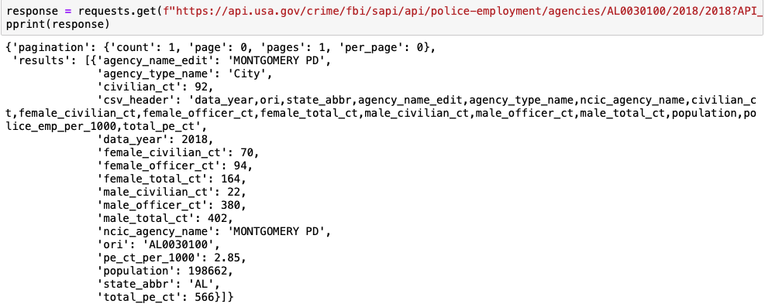
Getting Data-1
Example: Alabama Capital City, Montgomery Police Department
Notes:
FYC

Slide 2
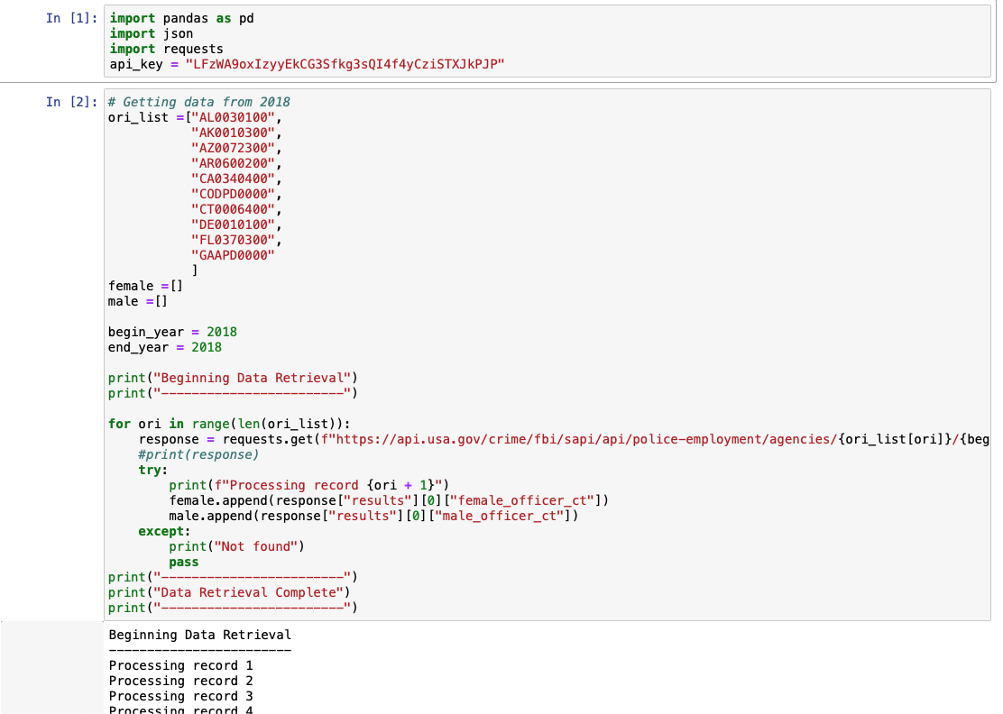
Getting Data-2
Notes:
FYC

Slide 3
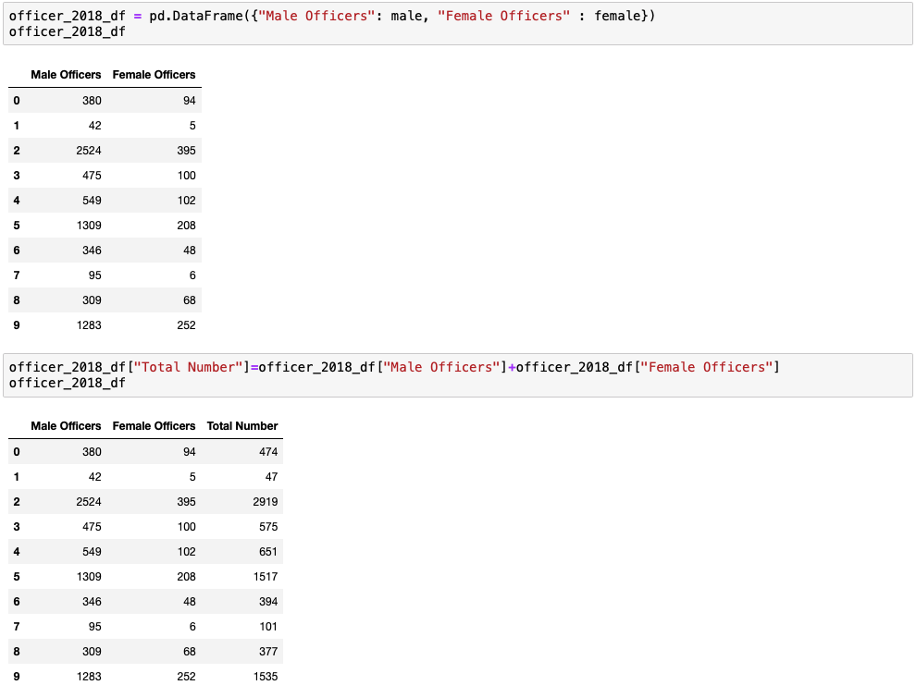
Getting Data-3
Example: Dataframe of 10 States
Notes:
FYC

Slide 4
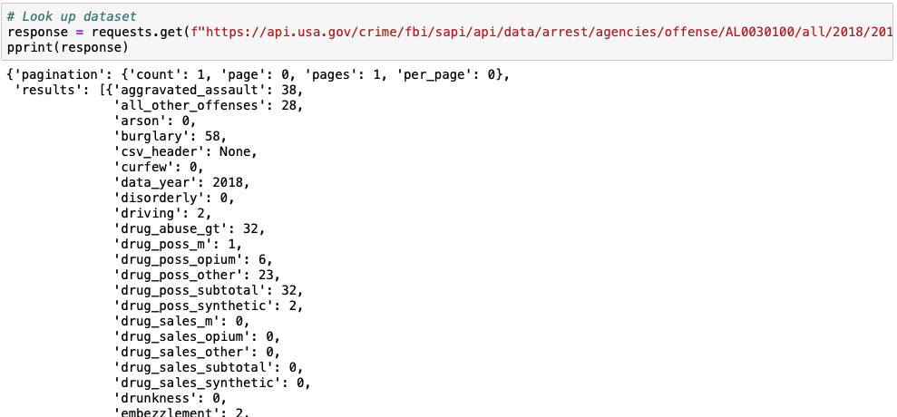
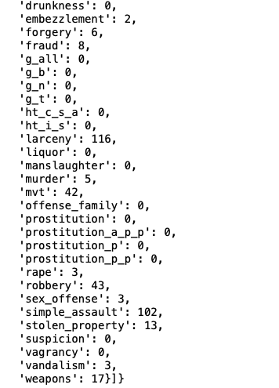
Getting Data-4
Example: Alabama Capital City, Montgomery Police Department
Notes:
FYC

Slide 5
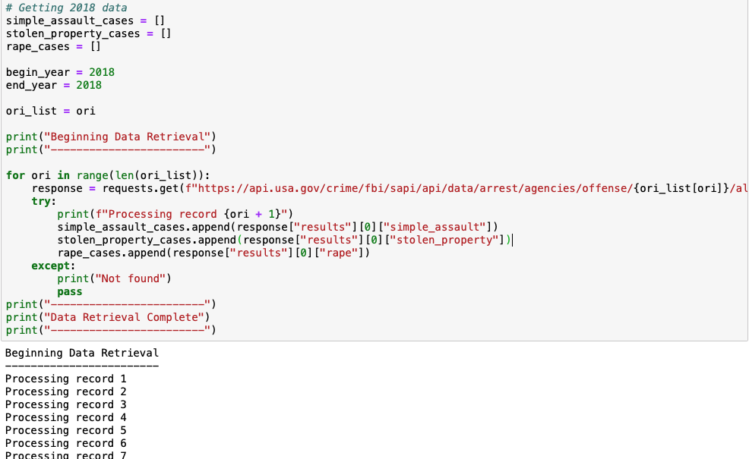
Getting Data-5
Notes:
FYC

Slide 6
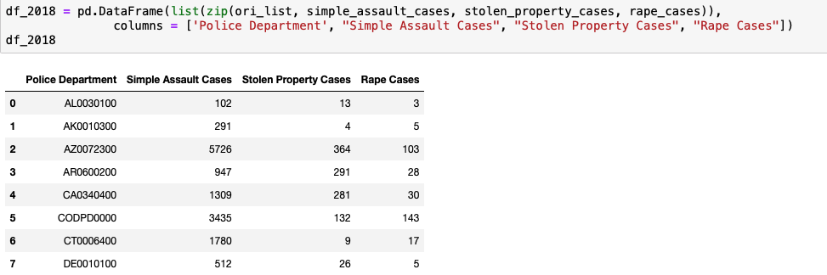
Getting Data-6
Example: Dataframe of 10 States
Notes:
FYC

Slide 7
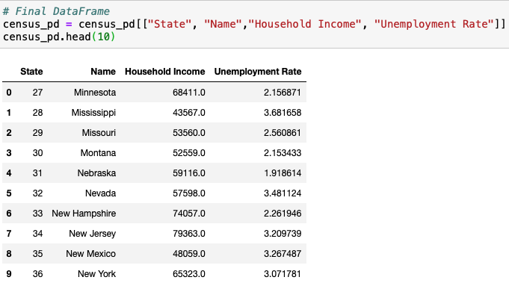
Getting Data-7
Example: Dataframe of 10 States
Coding reference: Python-APIs 09-Stu_Census_API_Gmap
Notes:
FYChang

Slide 8
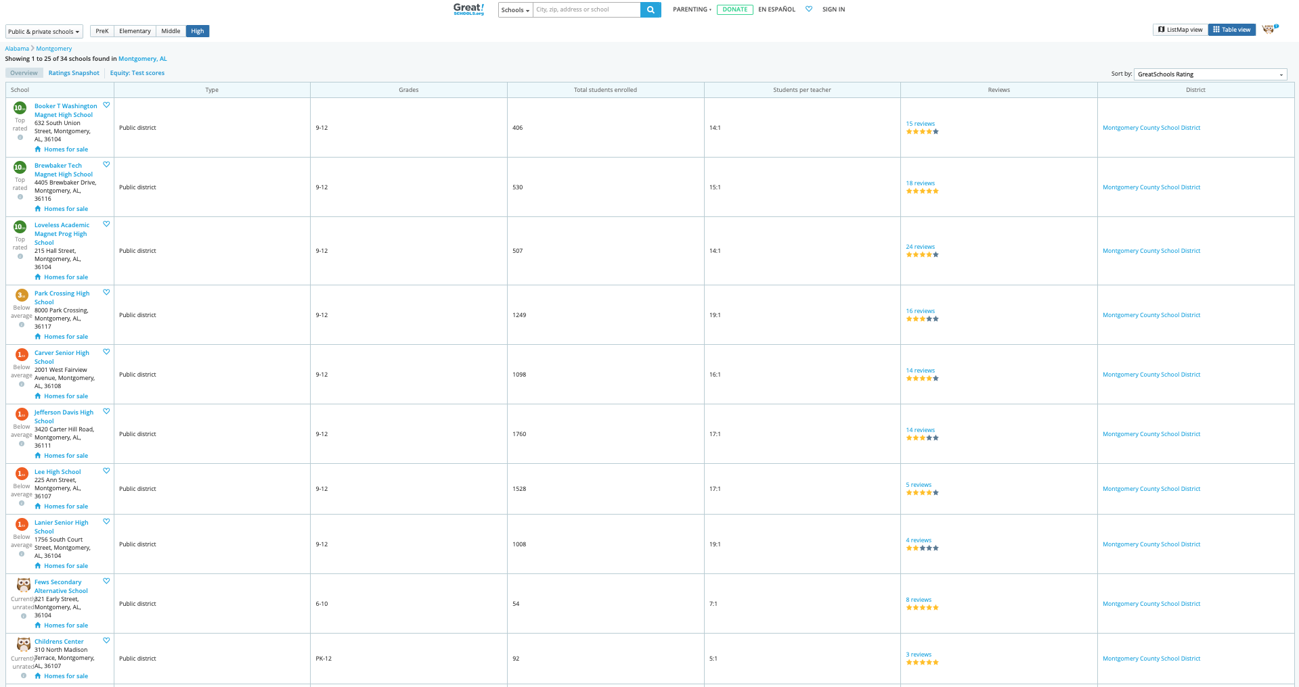
Getting Data-8
Example for School Rating: Alabama Capital City, Montgomery
https://www.greatschools.org
Notes:
FYChang

